Slide 1


By Annie Boochever with Roy Peratrovich Jr.
Gunalchéesh. Yak’éi yee xswateení
Thank you. It is good to see you all

Slide 2
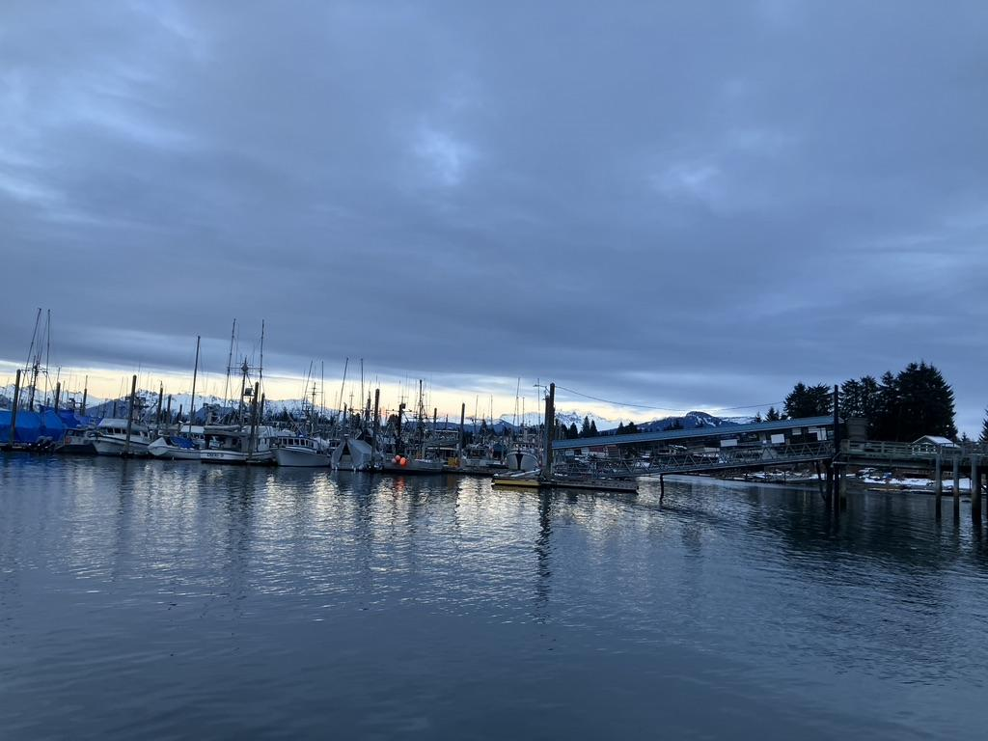
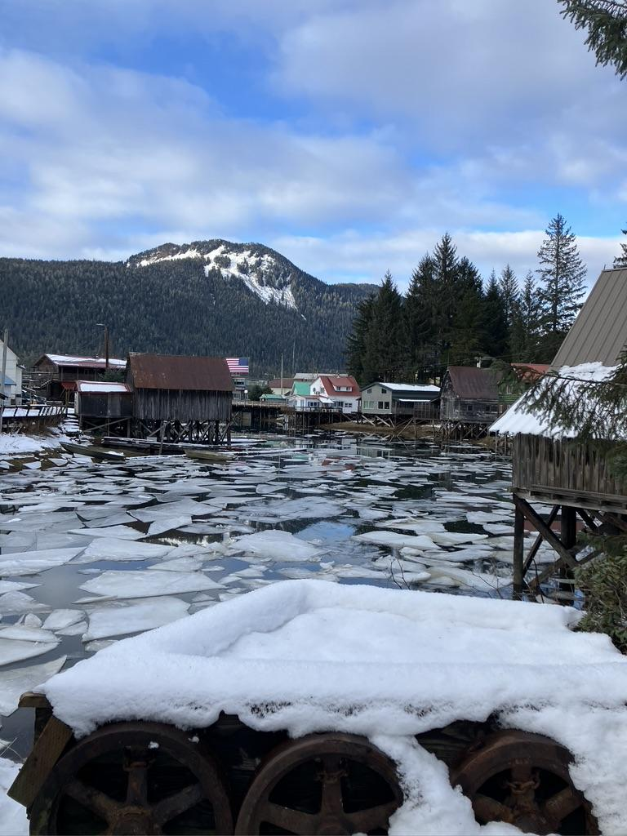
Notes:
Page 1
Narrator 1: Waves lap the shore

Slide 3
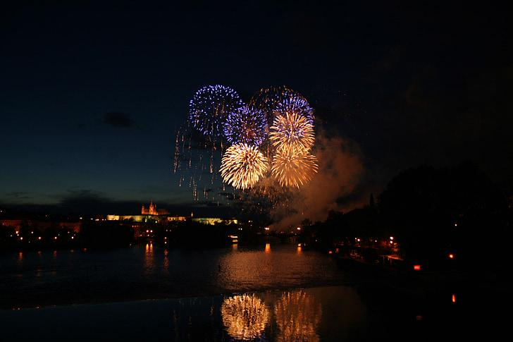
Séet ká
Petersburg, Alaska
Notes:
Page 2
Narrator 2: It is July 4th

Slide 4
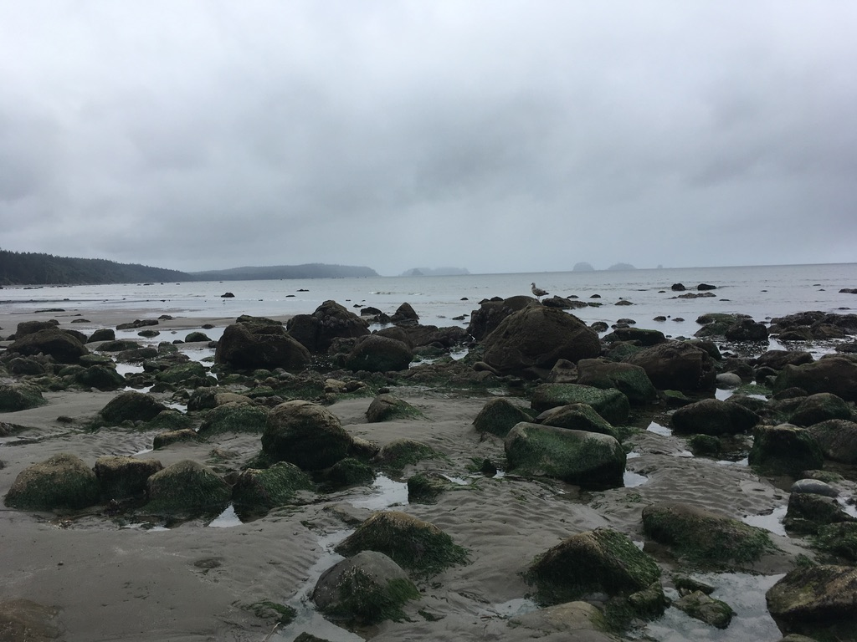
Łingít Aaní
Sacred Land of the Tlingit
Notes:
Page 2
Narrator 5: Sharp sea air swirls

Slide 5
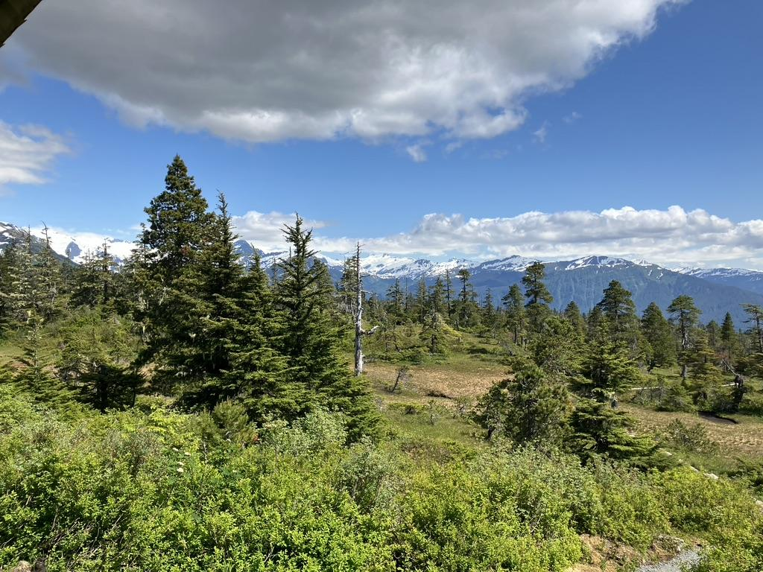
Notes:
Page 2
Narrator 6: Elizabeth runs and plays

Slide 6
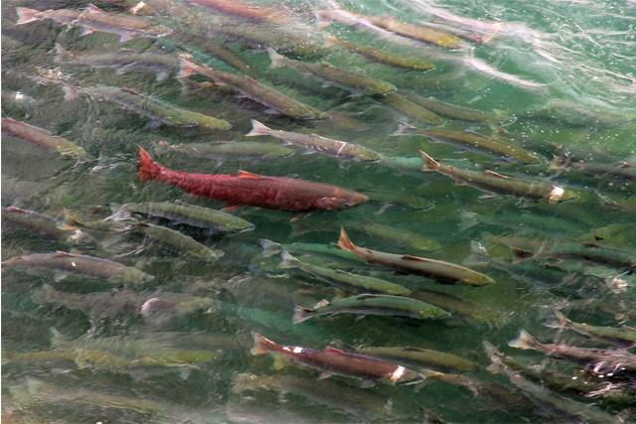
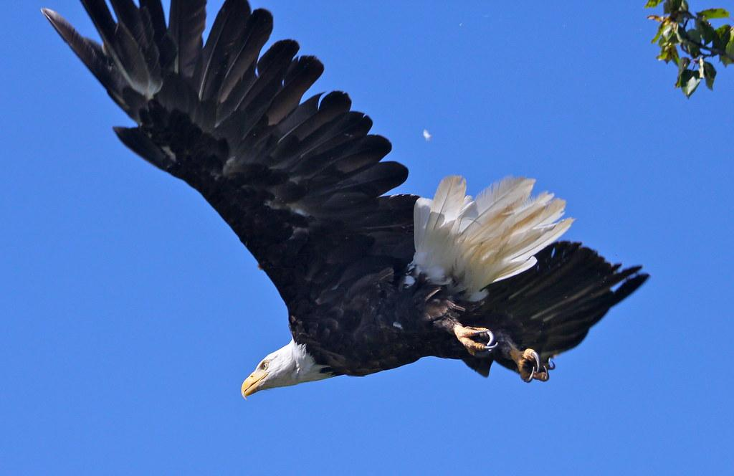
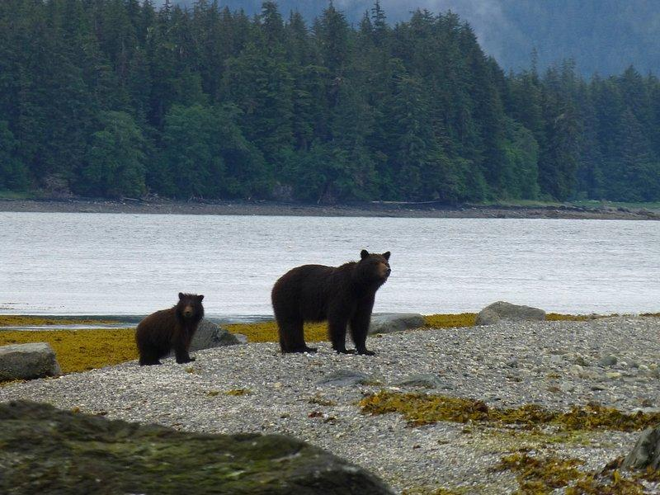
Notes:
Page 2
Narrator 7: For thousands of years

Slide 7
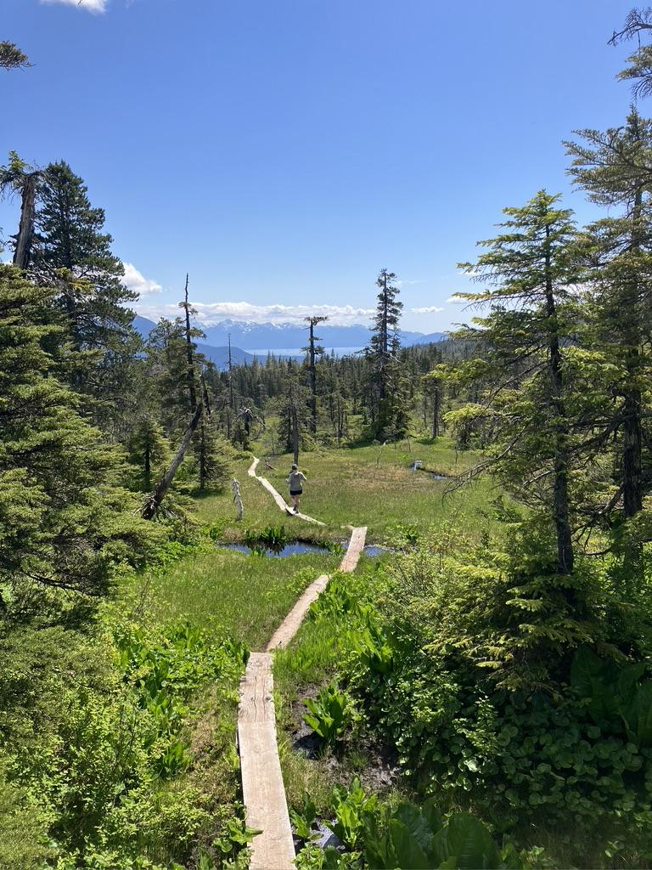
Notes:
Page 3
Narrator 10: When her little legs are strong enough

Slide 8
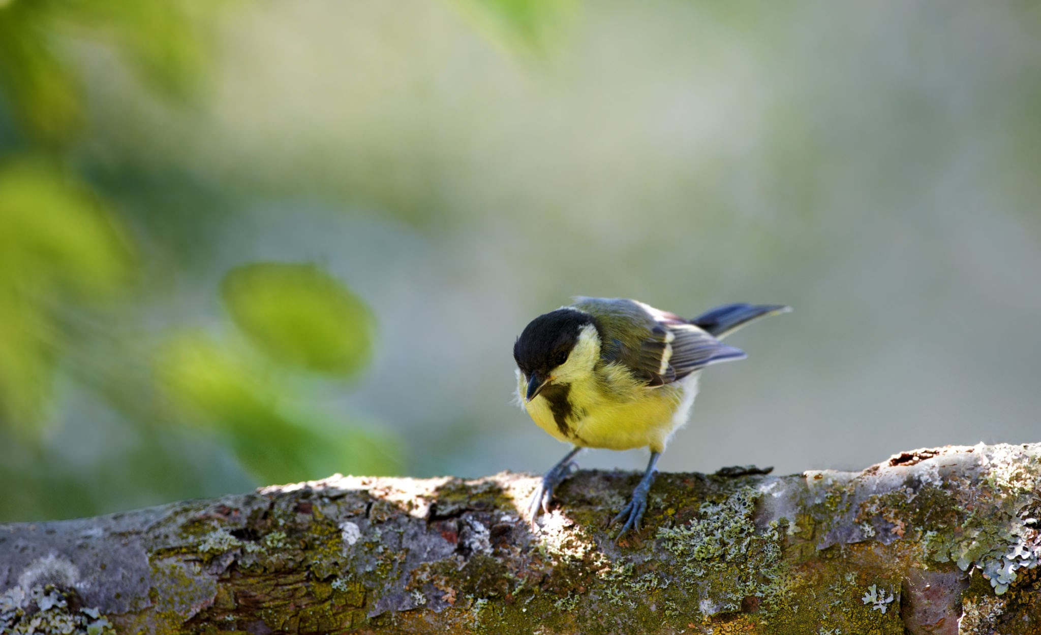
Notes:
Page 3
All Narrators: Chickadee

Slide 9
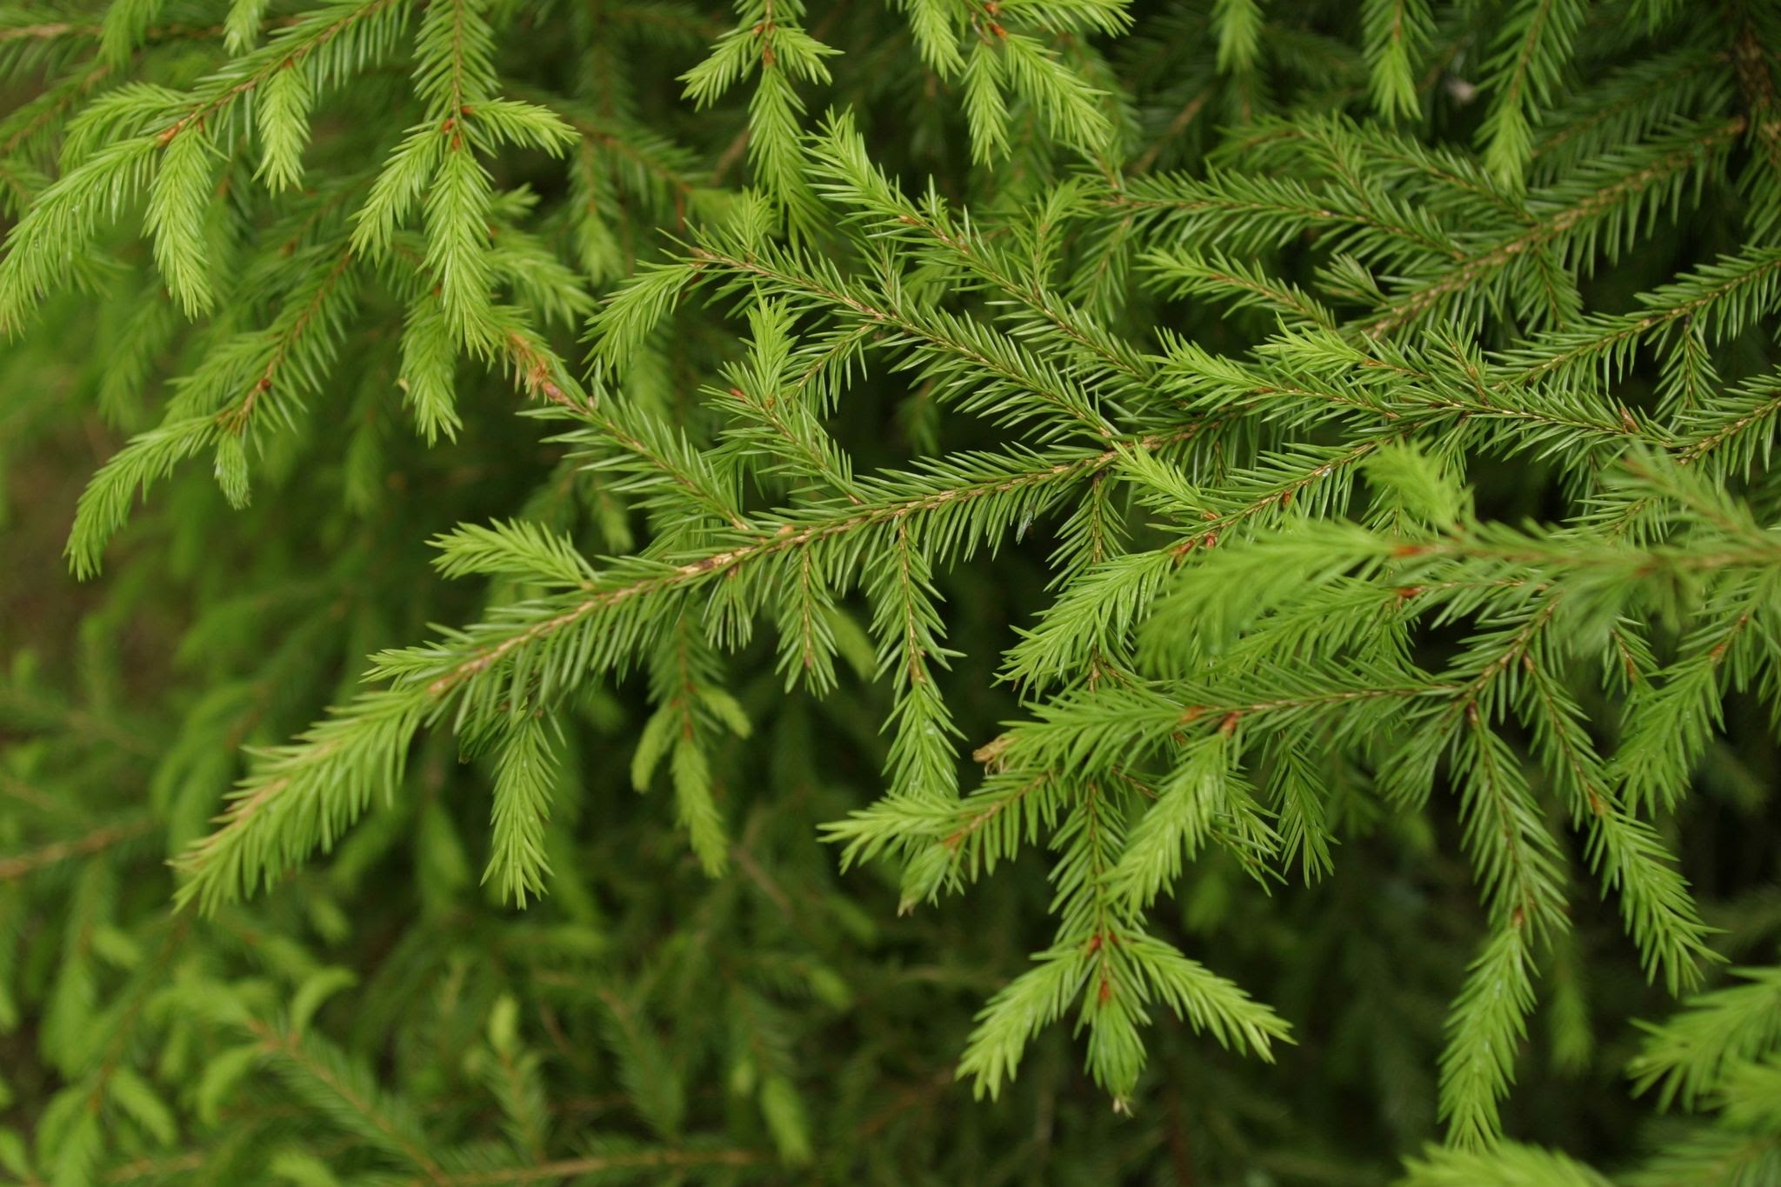
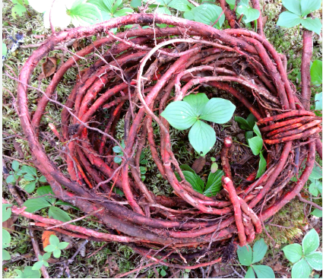
Notes:
Page 3
Elizabeth’s mother: “No, only get these ones”

Slide 10
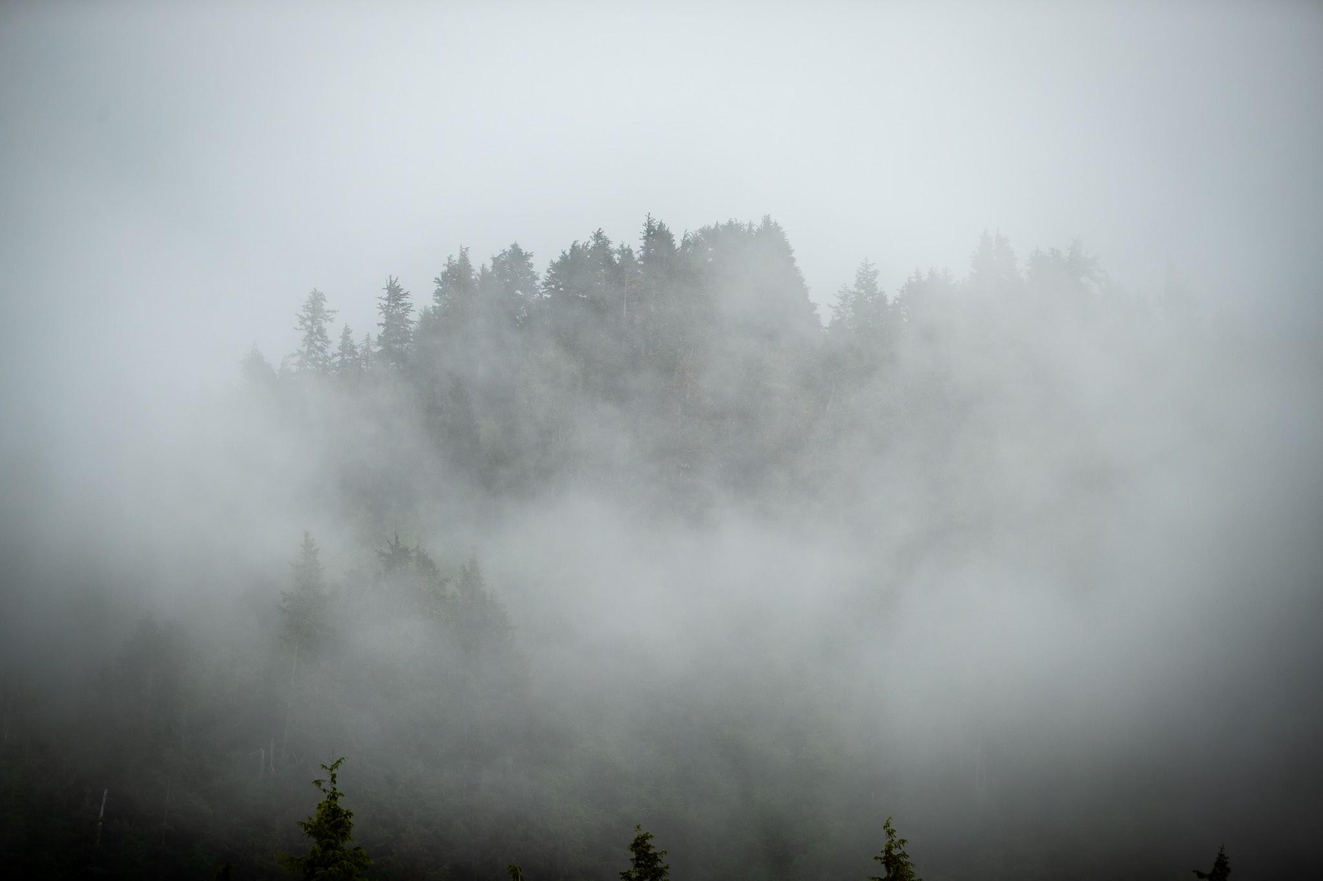
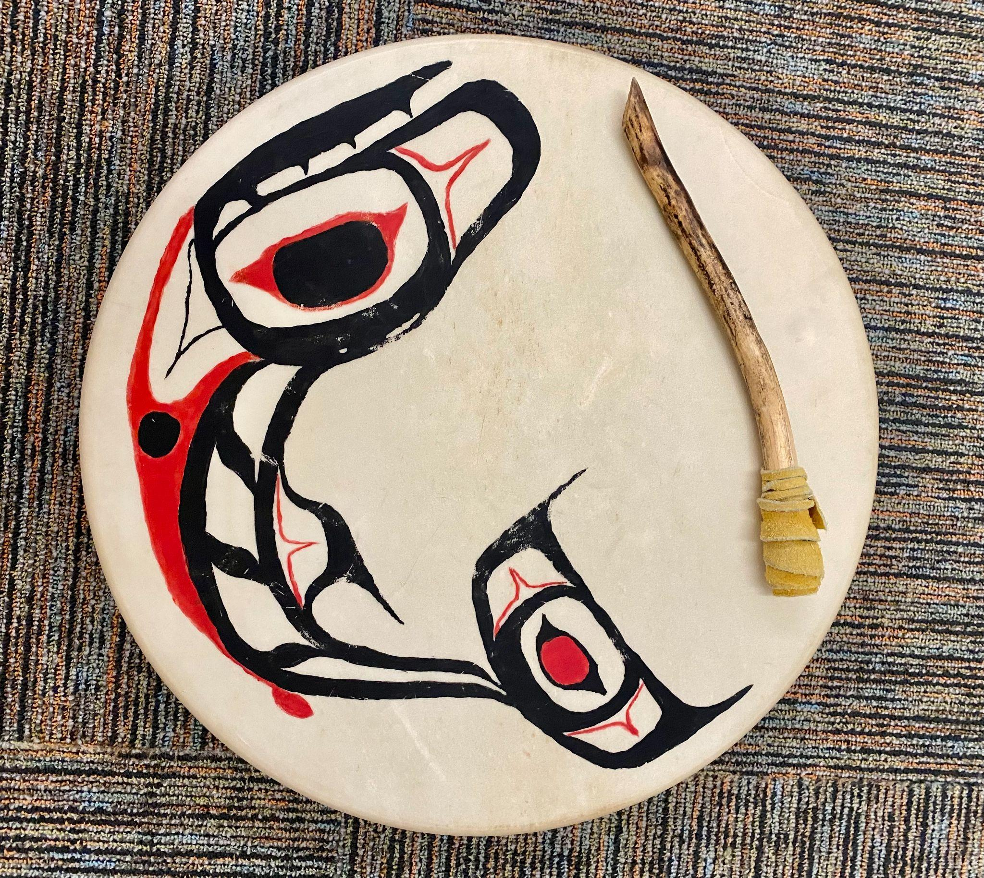
Haida Salmon
Artist: T.J. Young
Notes:
Page 4
Narrator 13: On special occasions everyone gathers

Slide 11
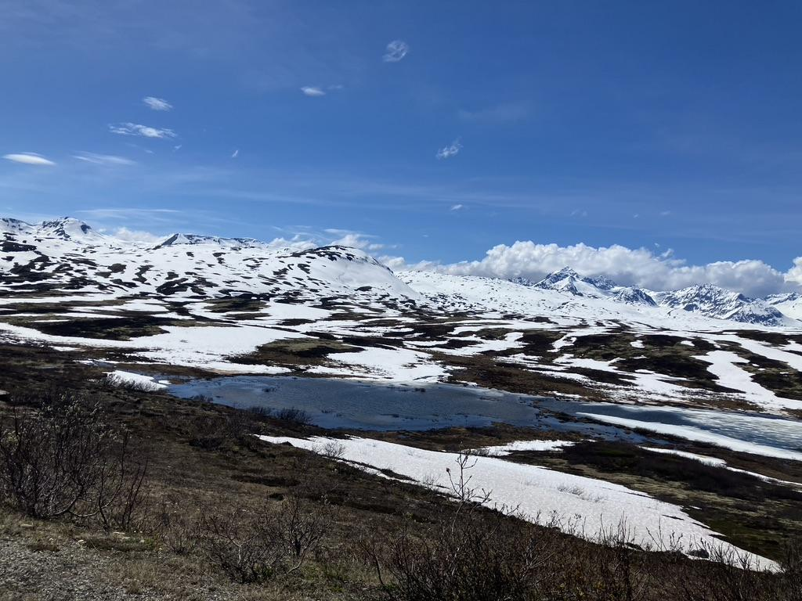
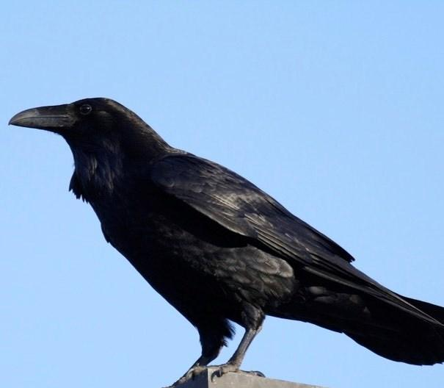
Notes:
Page 4
Elizabeth: Caw! Caw!

Slide 12
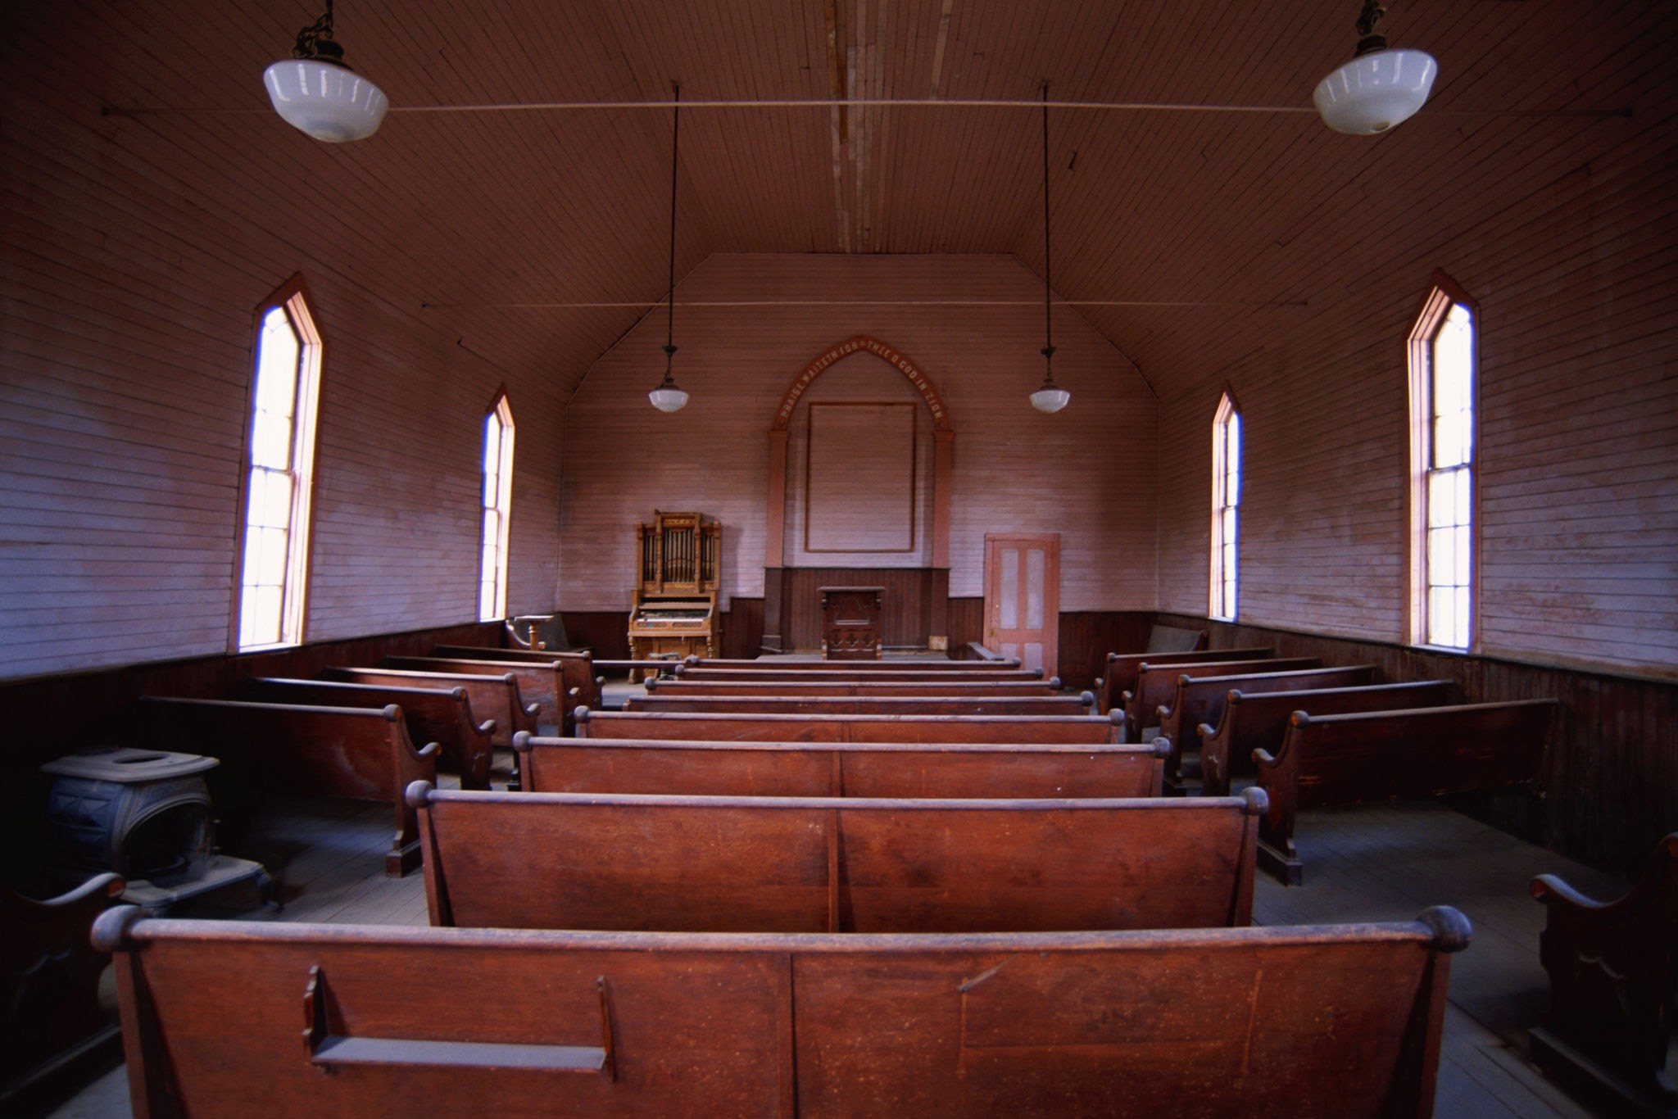
Notes:
Page 4
Narrator 14: When Elizabeth is old enough

Slide 13
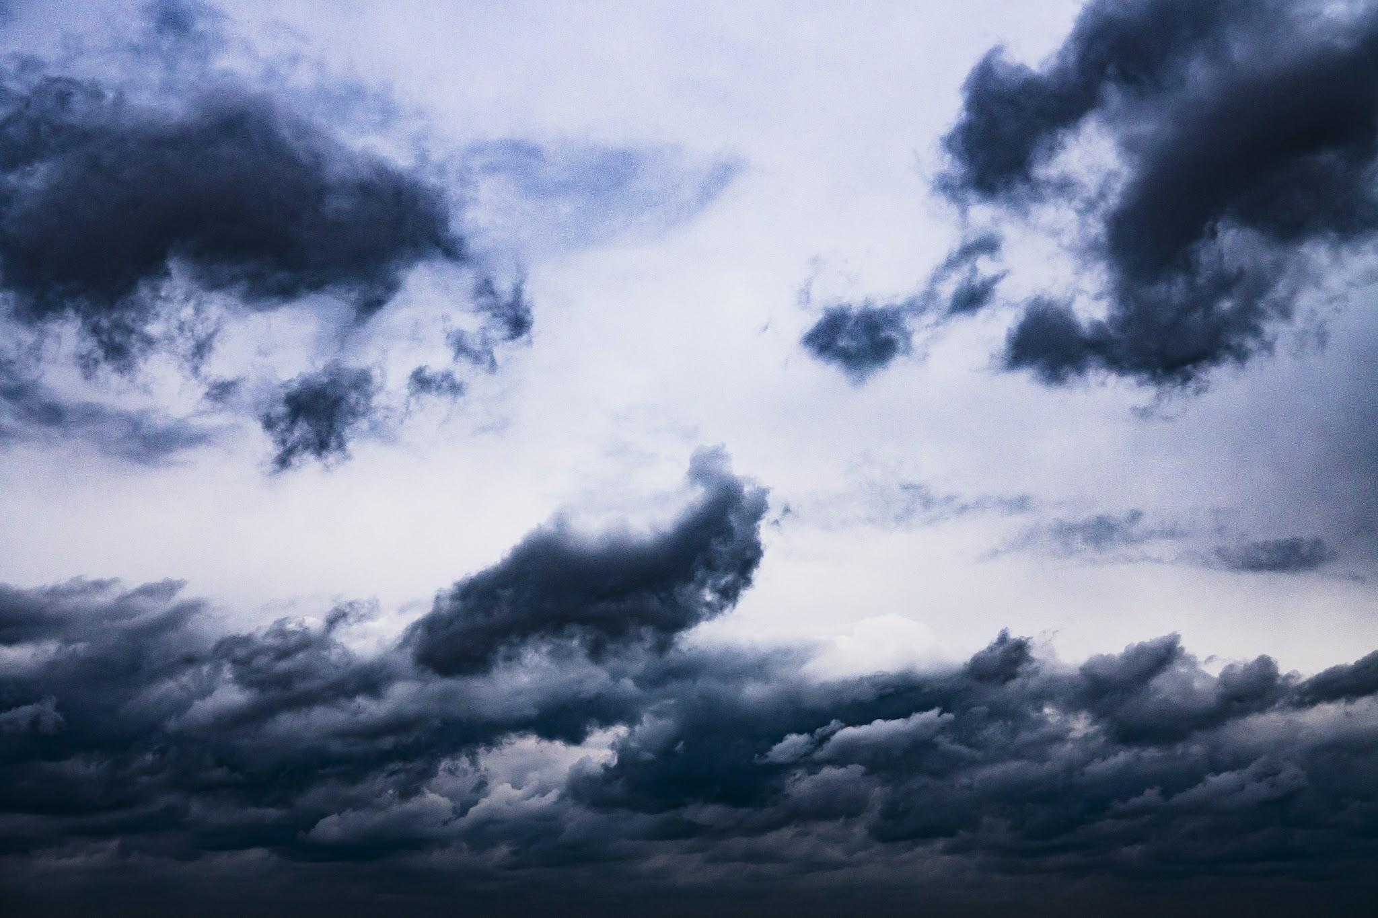
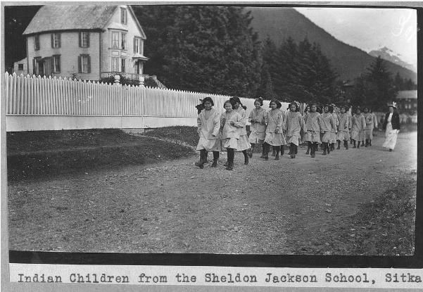
Kaaxgal.aat
Person who packs for herself
Notes:
Page 5
Narrator 17: Native children all over America

Slide 14
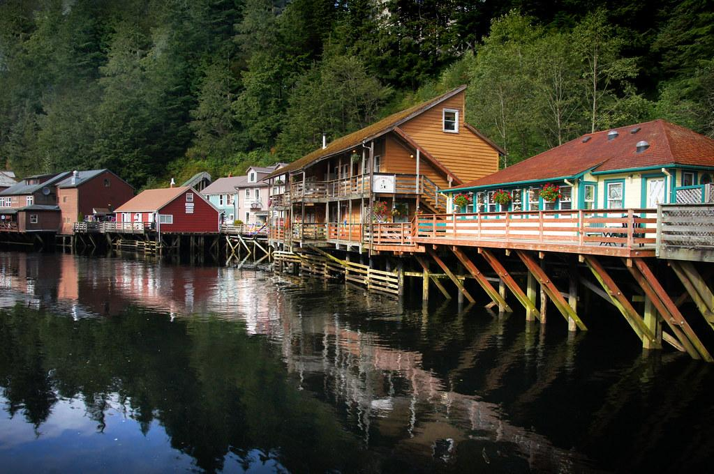
Notes:
Page 5
Narrator 20: Elizabeth rejoins her family

Slide 15
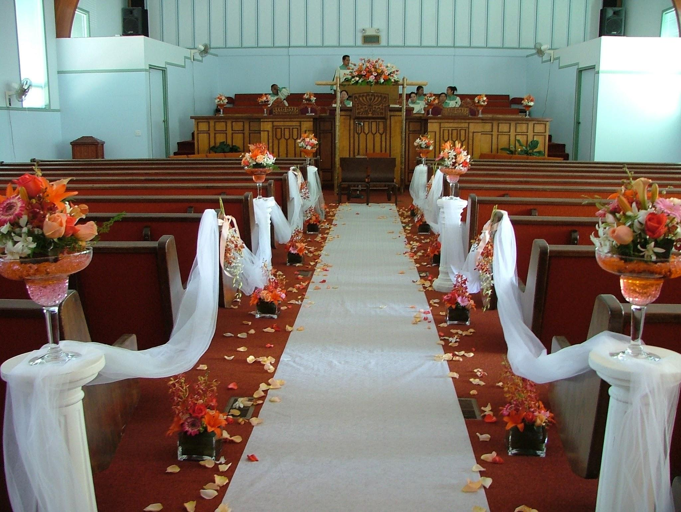
Notes:
Page 6
Narrator 22: After graduating, Elizabeth marries

Slide 16
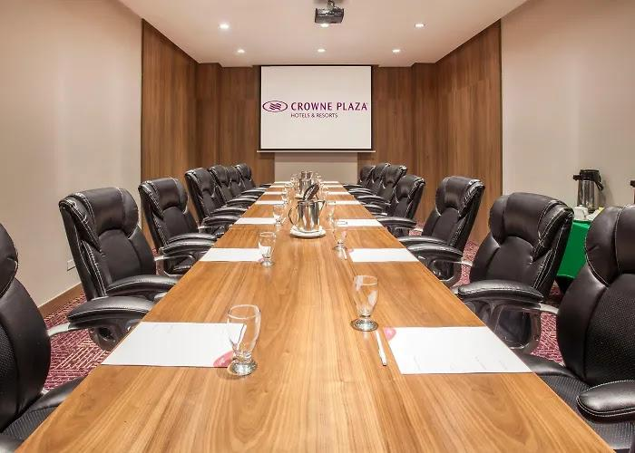


Notes:
Page 6
Narrator 23: Soon Roy joins the Alaska Native Brotherhood

Slide 17
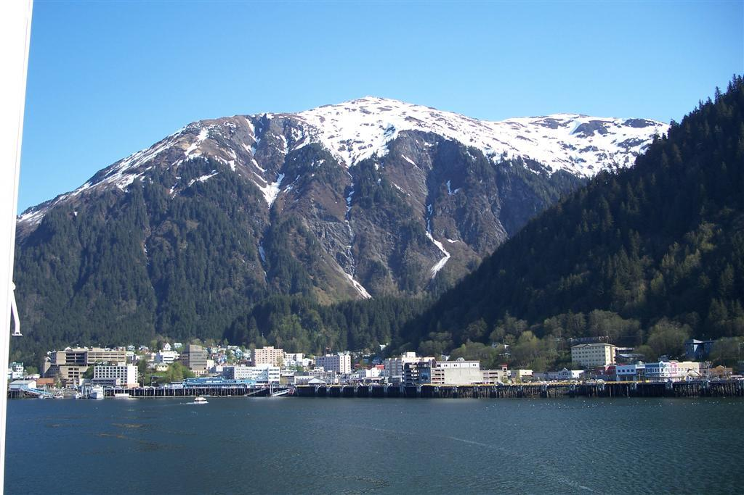
Notes:
Page 7
Narrator 27: But in Juneau….

Slide 18
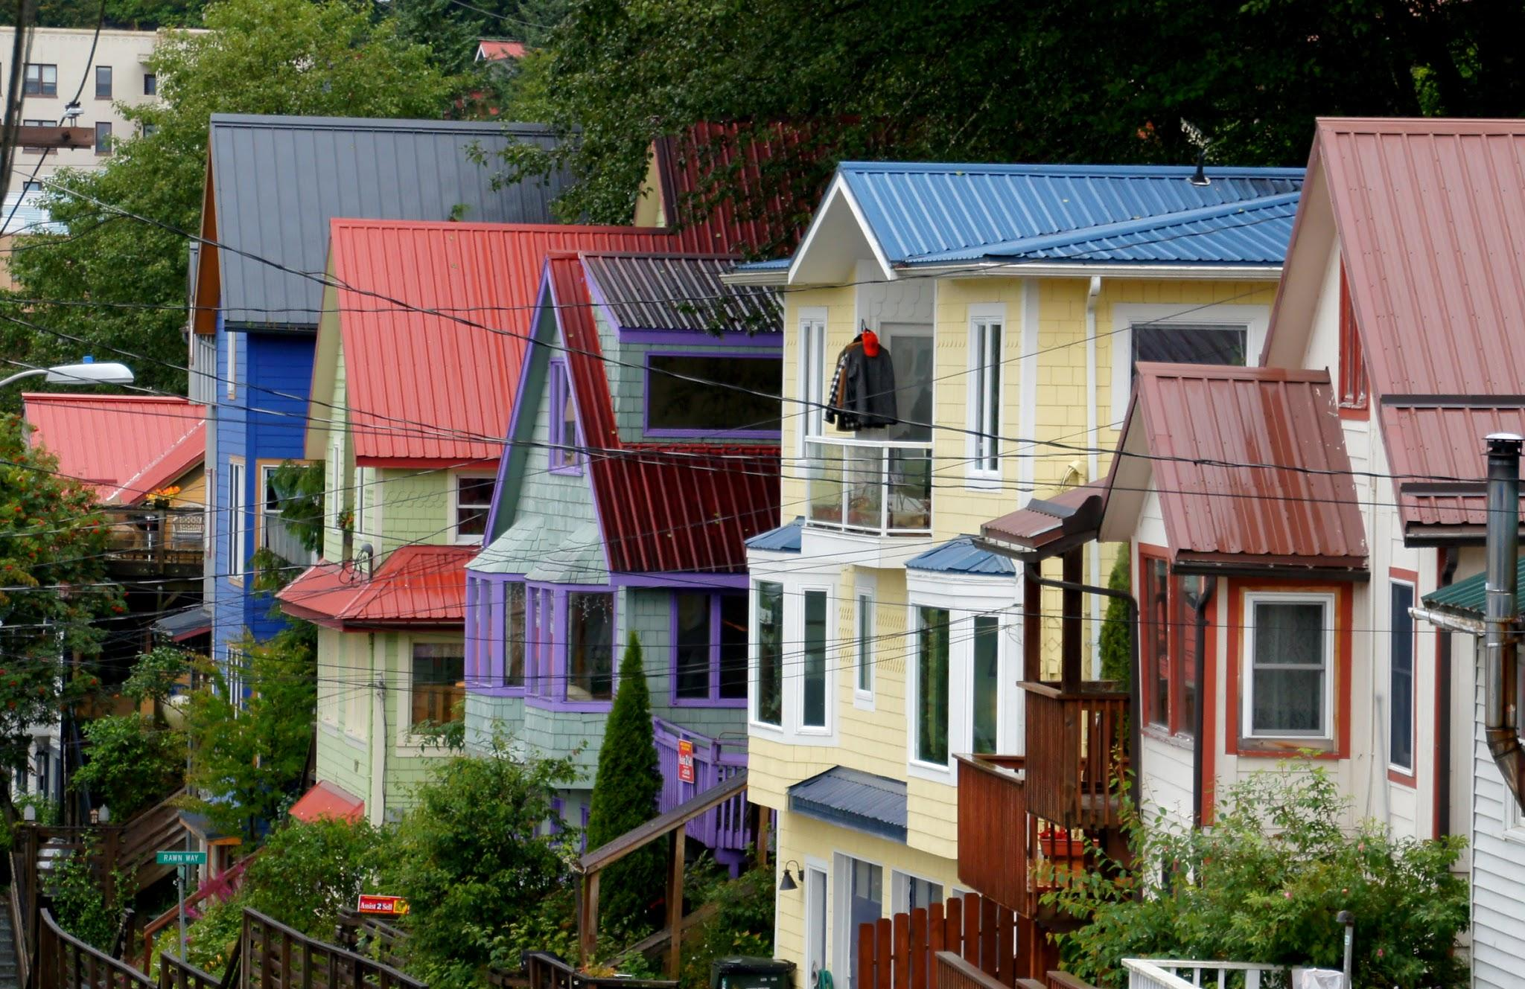
Notes:
Page 7
Landlord: Sorry but the neighbors don’t want

Slide 19
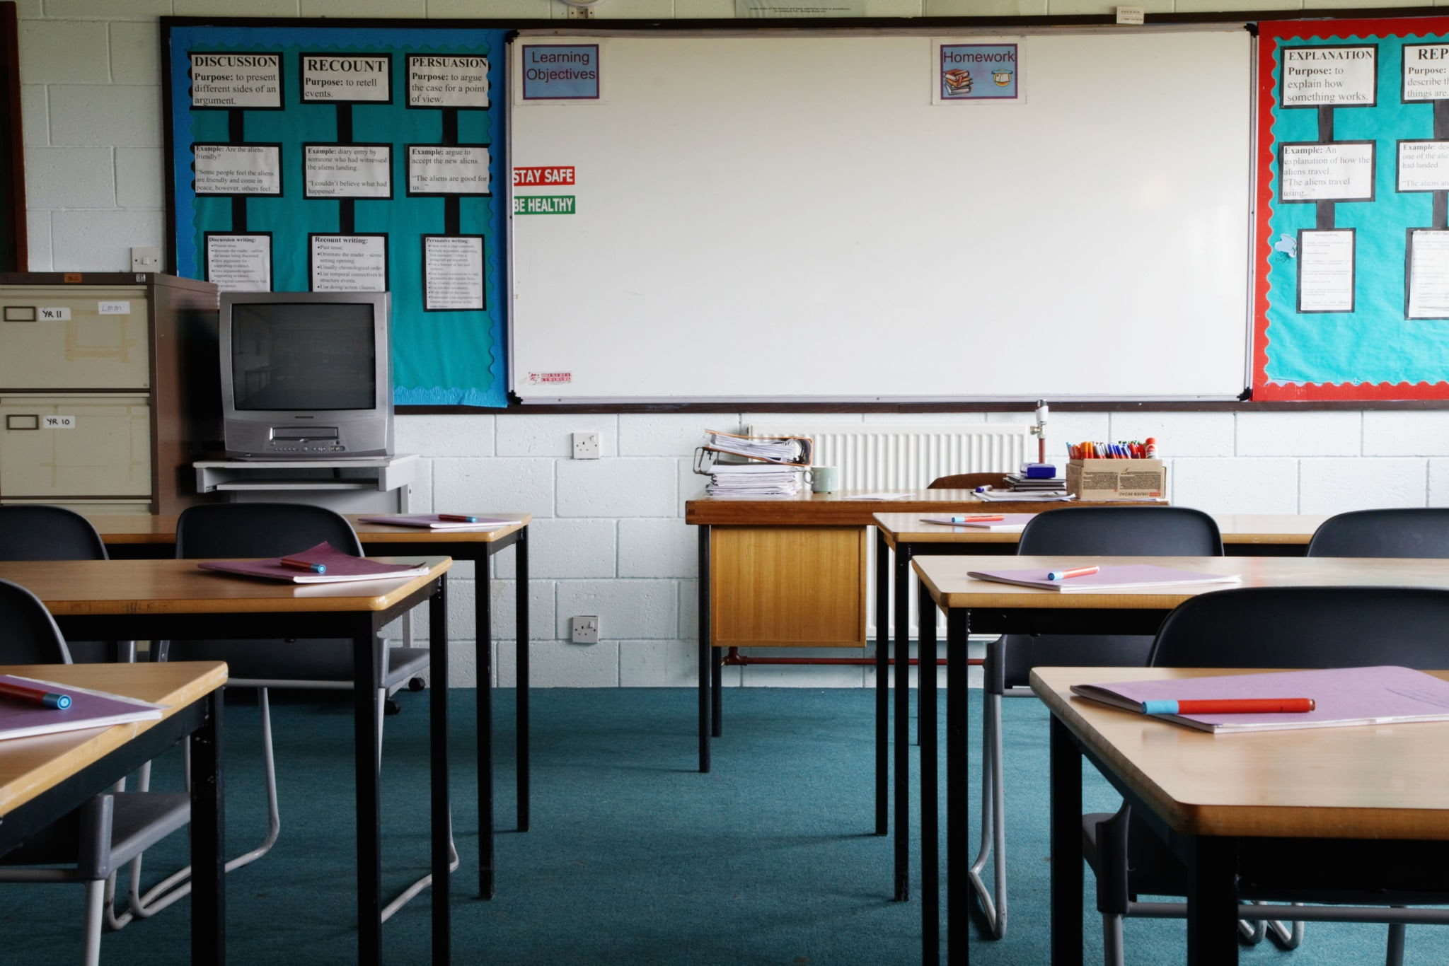
Notes:
Page 7
Narrator 29: Finally they do find a home

Slide 20

Notes:
Page 7
Narrator 30: And at the movie theatre

Slide 21
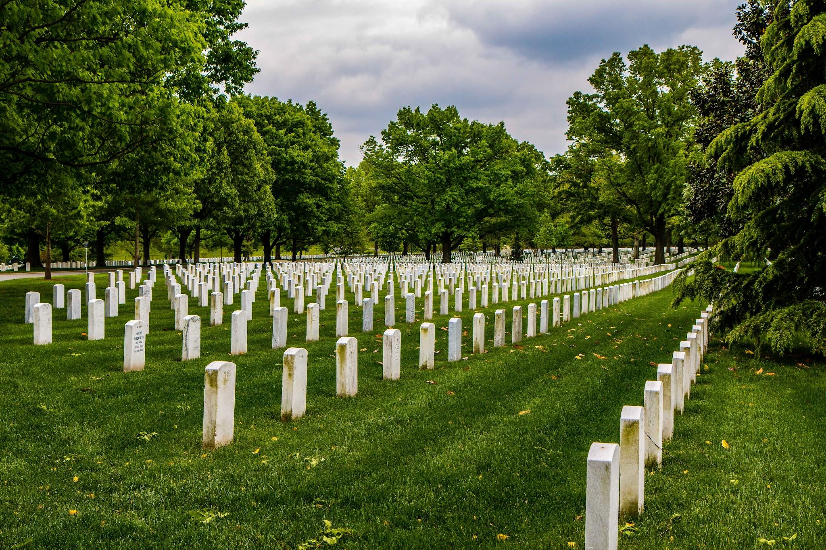
Notes:
Page 8
5th student: the best parts of the cemetery

Slide 22
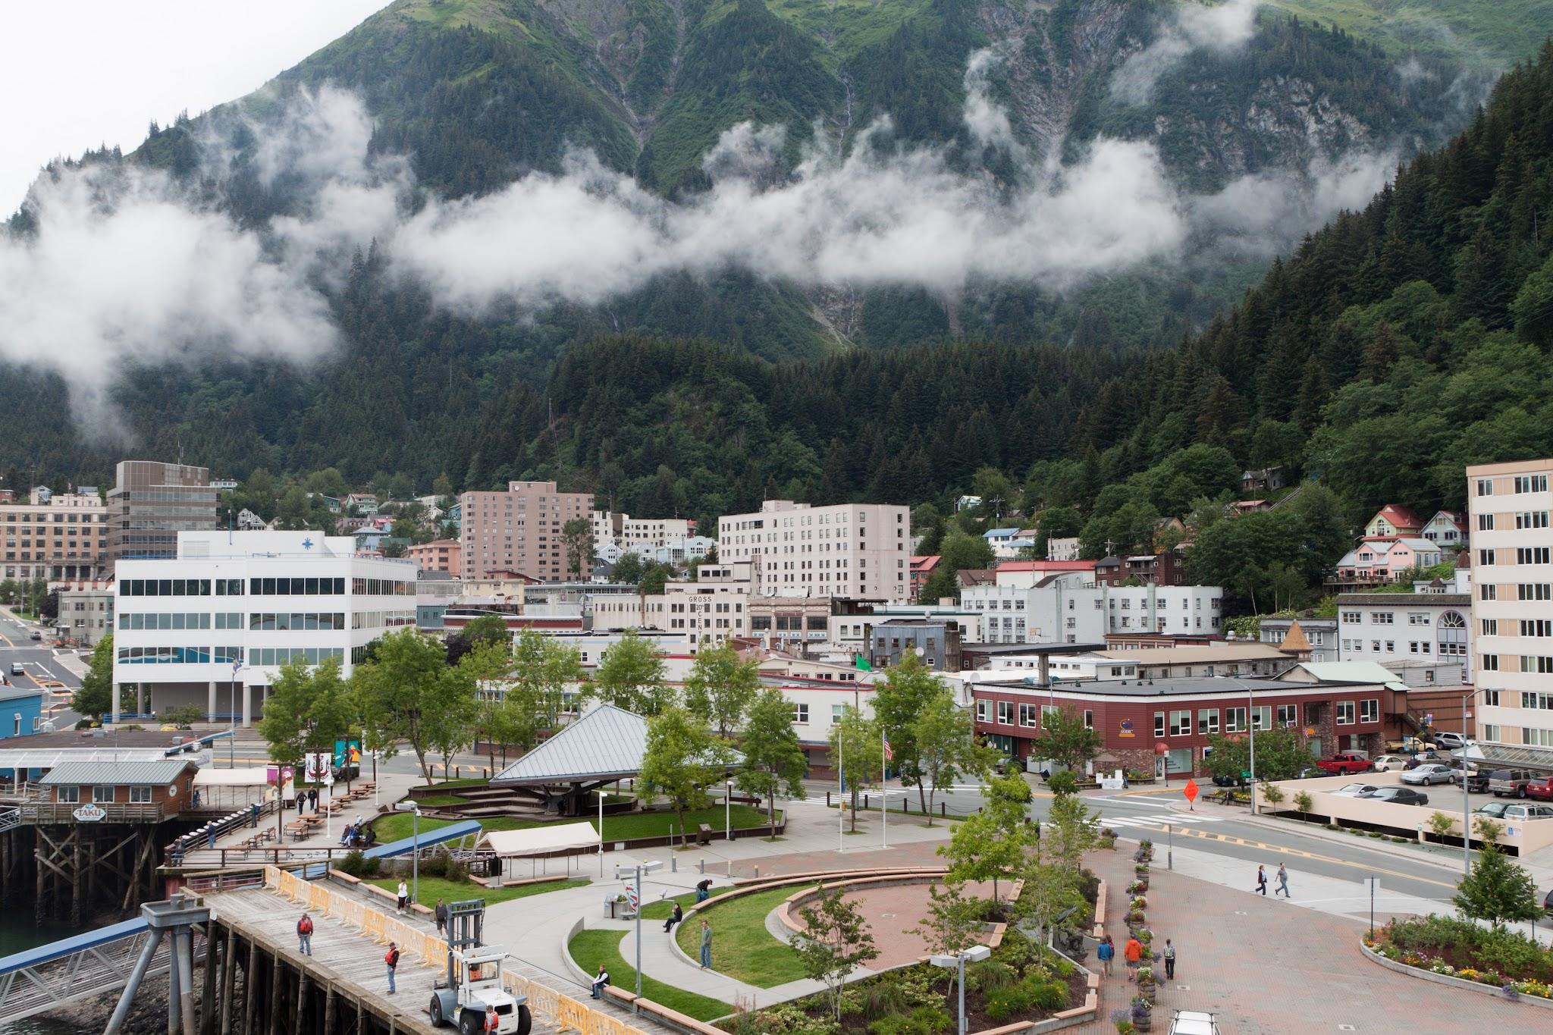
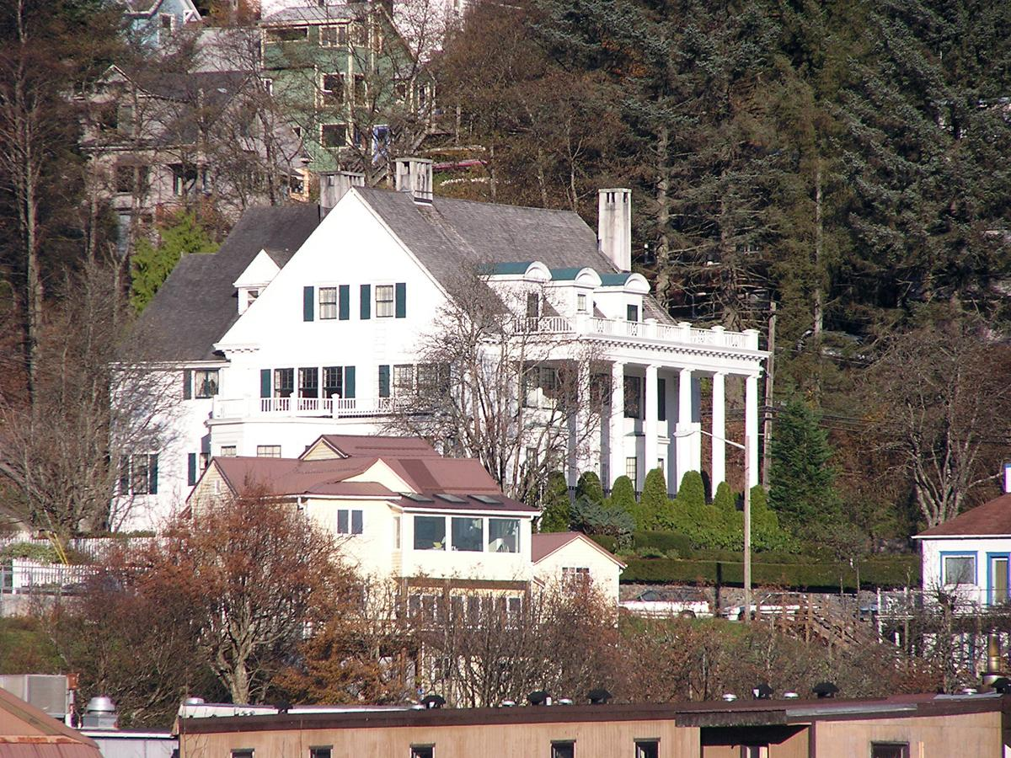
Notes:
Page 9
Narrator 7: Near the top of a steep hill

Slide 23

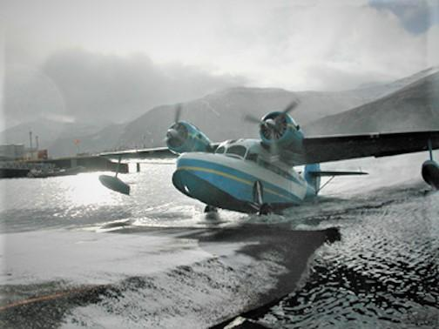
Notes:
Page 10
Narrator 13: The engines whir to life and the plane glides through the water.

Slide 24
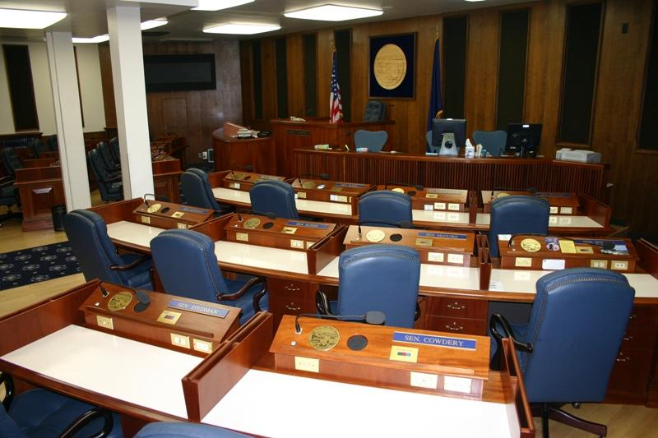
All opposed?
Notes:
Page 11
Narrator 18: On February 5, 1945

Slide 25
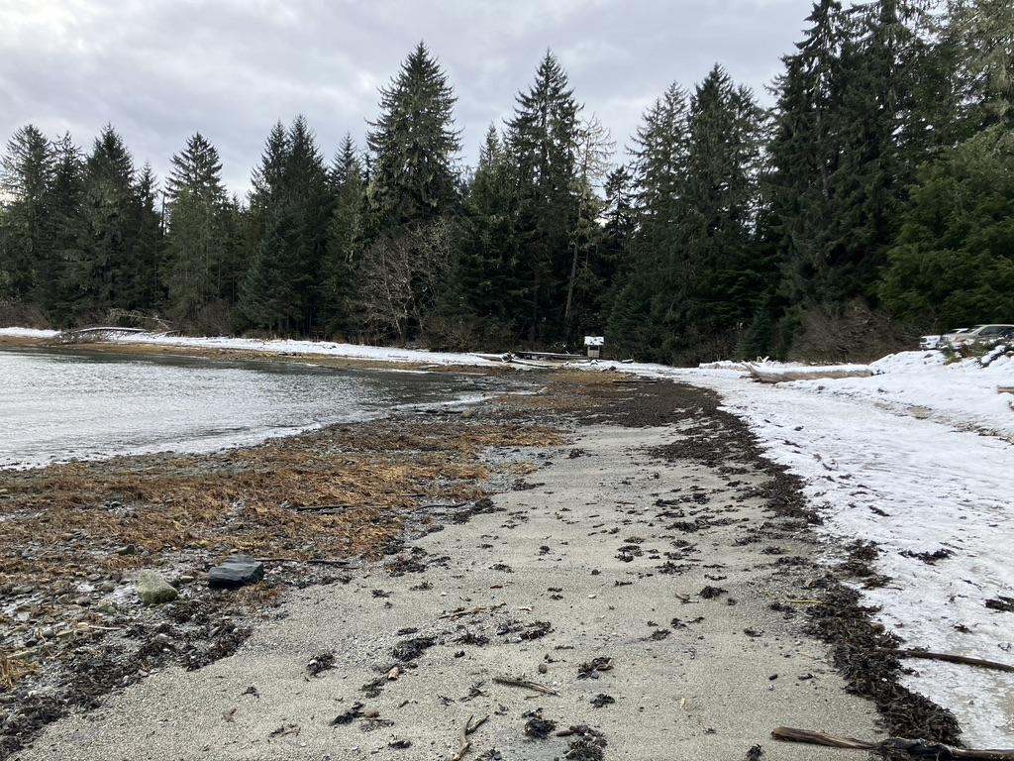
Full and equal accommodations, facilities, and privileges to all citizens in places of public accommodations
in the Territory of Alaska

Slide 26
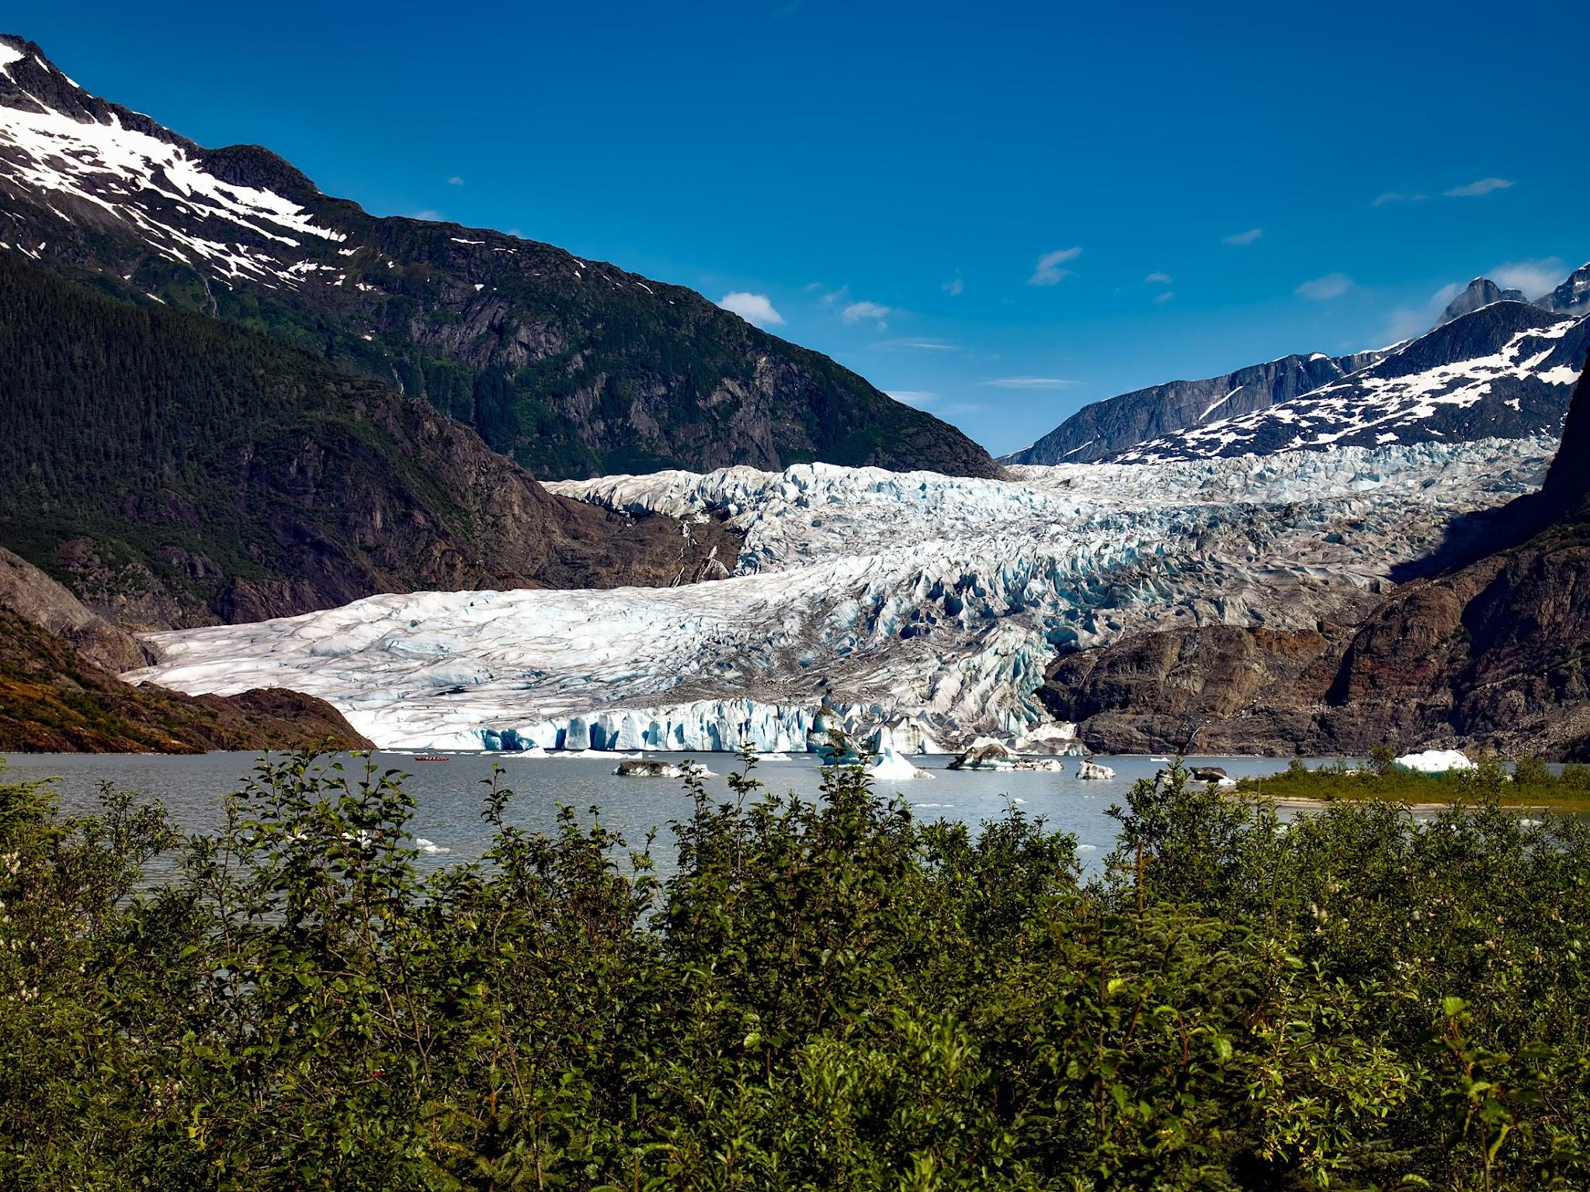
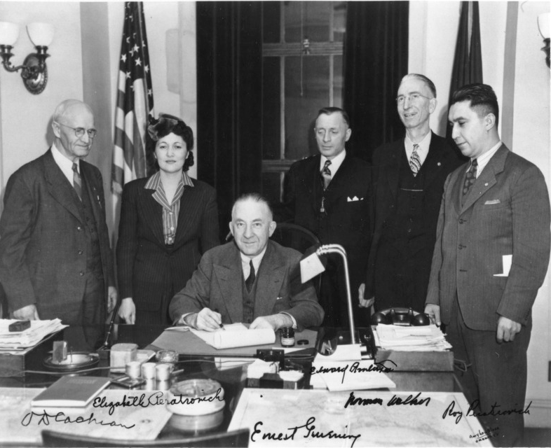
Notes:
Page 12
Narrator 27: That night, Roy and Elizabeth
https://www.nlm.nih.gov/nativevoices/assets/timeline/000/000/025/25_w_full.jpg

Slide 27

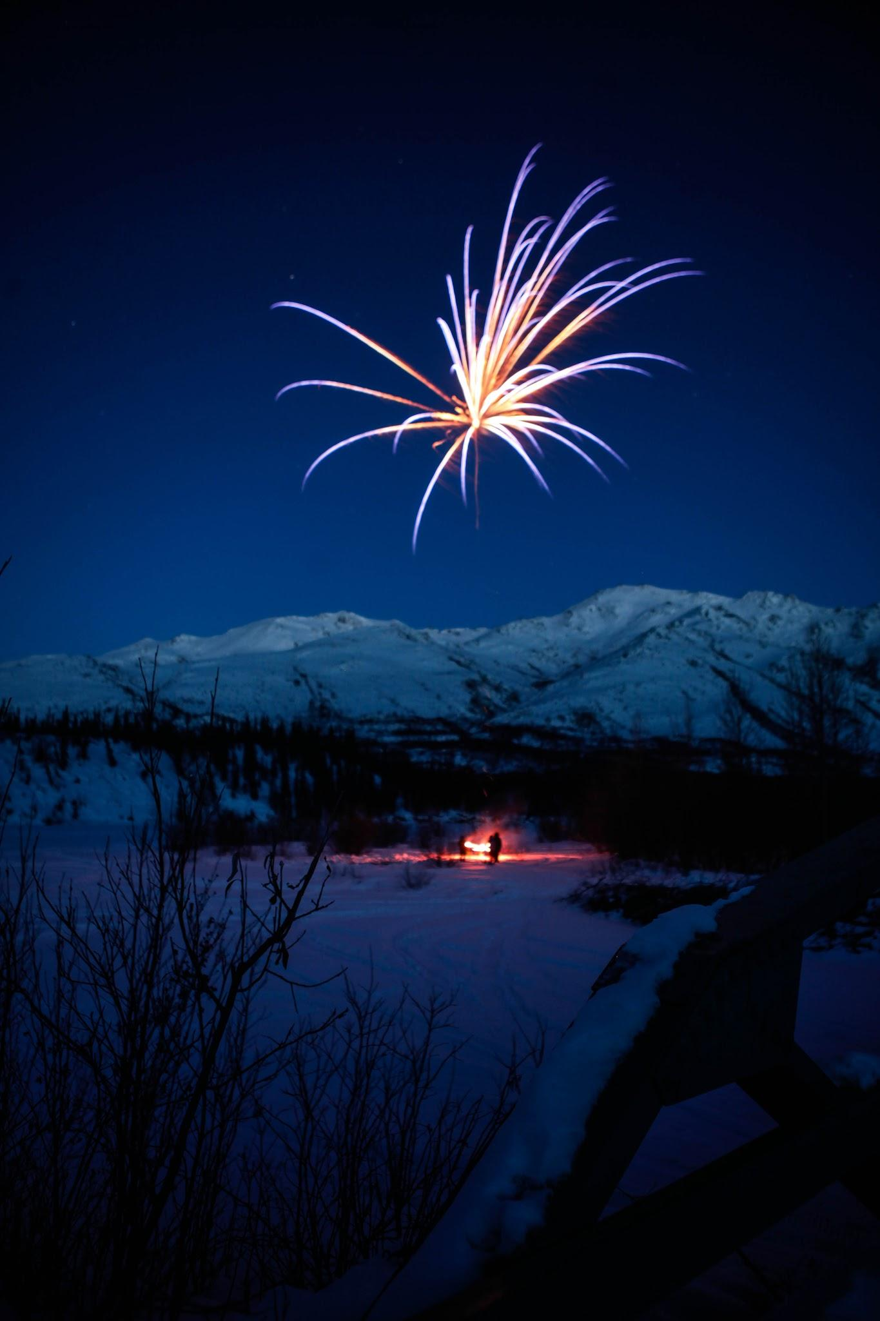

Slide 28
Gunalchéesh!

